Slide 1
ENTERPRISE AI
RAG
LLAMAINDEX
LlamaIndex for Enterprise RAG Applications
From Enterprise Data to Intelligent AI Systems
Presented by: Jaina Sumith Gupta
What is LlamaIndex
RAG Architecture
Real-Time Implementations
Retrieval Techniques
Enterprise Use Cases
Future Scope

Slide 2
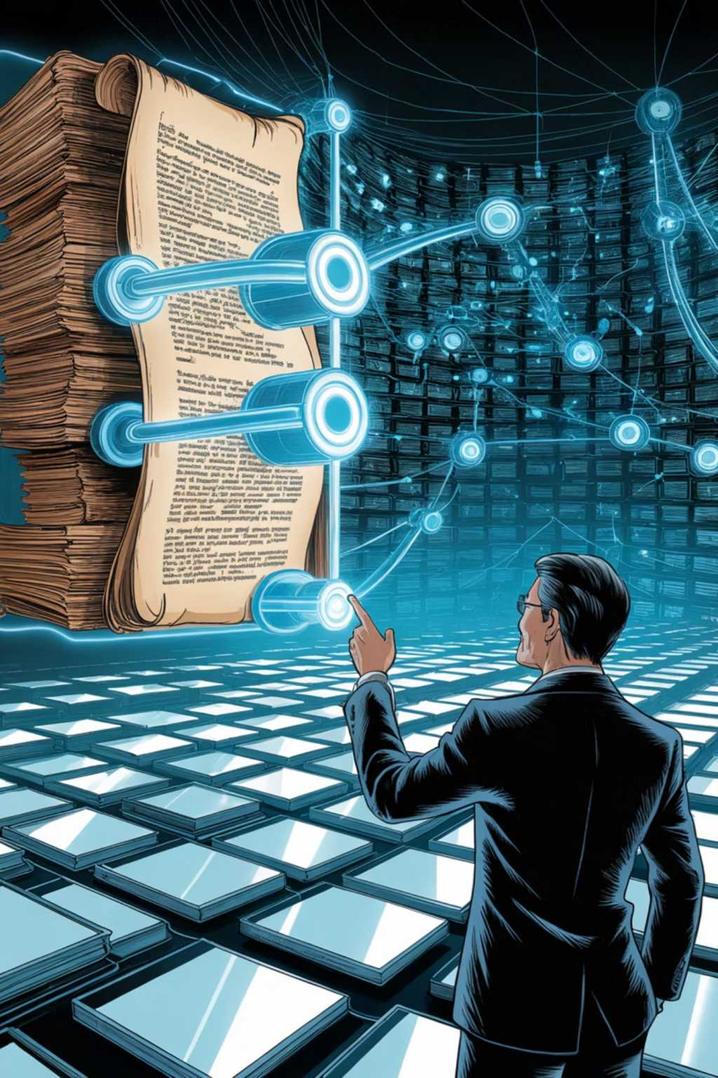

What is LlamaIndex?
LlamaIndex is a purpose-built data framework that bridges enterprise and private data sources with Large Language Models (LLMs). It serves as the knowledge layer between raw organisational data and AI systems, enabling accurate, context-aware responses grounded in your own documents and databases.
Why It Is Used
Builds end-to-end RAG applications
Handles document ingestion and parsing
Creates and manages embeddings
Supports semantic and hybrid retrieval
Integrates with leading vector databases
Improves answer accuracy and reduces hallucinations
Supported Integrations
LLM Providers: Groq, OpenAI, Ollama
Embeddings: HuggingFace
Vector Stores: PostgreSQL/PGVector, ChromaDB
Key Insight: LlamaIndex acts as the knowledge layer between enterprise data and LLMs — transforming unstructured documents into intelligent, queryable knowledge.

Slide 3
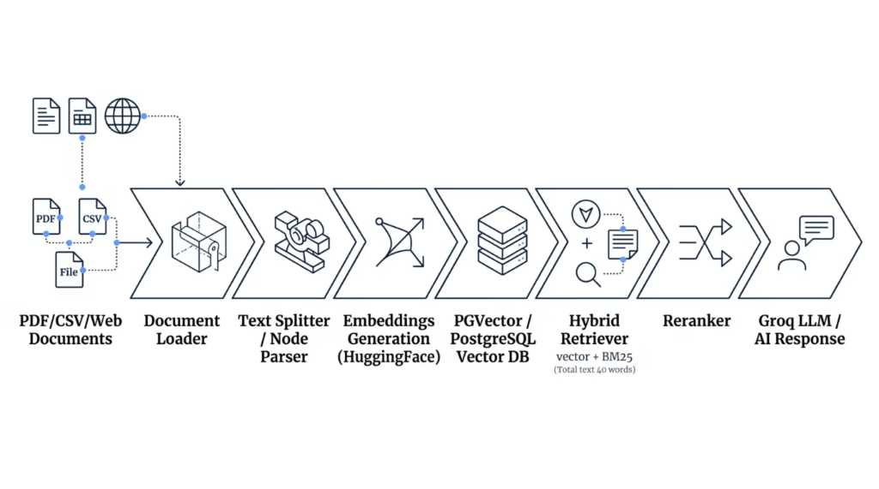

Real-Time Implementation Architecture
Enterprise RAG Pipeline
The end-to-end pipeline transforms raw enterprise documents into intelligent, context-aware AI responses. Each stage is optimised for accuracy, speed, and scalability — from document ingestion through to LLM-powered output generation.
This architecture leverages LlamaIndex for orchestration, HuggingFace for embeddings, PGVector for persistent storage, and Groq for ultra-low-latency inference — delivering production-ready RAG performance.

Slide 4
Core Components Implemented
Each component in the pipeline plays a distinct role in ensuring documents are ingested, processed, stored, and retrieved with precision. Together, they form a robust, production-grade RAG system.
📄 Document Loading
✂️ Text Splitting
🔢 Embeddings
PDF Reader
File Loader
Web Content Loader
Sentence Splitter
Recursive Splitter
Token Splitter
Semantic Chunking
HuggingFace Embeddings
Semantic Vector Creation
High-dimensional representations
🗄️ Vector Storage
🔍 Retrieval
PostgreSQL + PGVector
Persistent vector storage
SQL-compatible querying
Vector Search
BM25 Keyword Search
Hybrid Retrieval

Slide 5
Hybrid Retrieval & Reranking
Advanced Retrieval Pipeline
Three-Layer Retrieval Strategy
Reranking Layer
After hybrid retrieval, the top candidate chunks are passed through a reranker that scores and reorders them by true relevance before delivery to the LLM. This critical step ensures only the most pertinent context reaches the model.
Vector Retrieval
Finds semantically similar content using embedding similarity — captures meaning beyond exact words.
Reduces Hallucinations
Improves Response Quality
BM25 Retrieval
Finds keyword-based exact matches — ensures precise term-level recall for technical queries.
Filters out weakly relevant context
Sharper, more accurate AI outputs
Hybrid Retrieval
Enterprise Search Accuracy
Combines semantic and keyword search for superior accuracy and context relevance.
Reliable results for critical queries

Slide 6






End-to-End RAG Workflow
From user query to context-aware AI response in milliseconds. The real-time RAG workflow delivers intelligent, grounded answers by combining hybrid retrieval, reranking, and fast LLM inference through Groq.
User Query
Natural language question from end user
Hybrid Retriever
Vector + BM25 search across document store
Reranker
Scores and reorders top chunks by relevance
Groq LLM
Generates context-aware, grounded response
IT Support Assistant
Answers technical queries from internal documentation and runbooks.
Document Q&A Bot
Enables natural language queries across PDFs, policies, and reports.
Incident RCA Assistant
Accelerates root cause analysis by surfacing relevant historical incidents.
Internal Knowledge Search
Unifies organisational knowledge into a single intelligent search interface.

Slide 7

LlamaIndex vs LangChain vs LangGraph
These three frameworks are frequently discussed together, but each serves a distinct purpose in the AI application stack. Understanding their roles helps teams make informed architectural decisions.
Technology
Primary Purpose
Best Used For
LlamaIndex
Data ingestion & retrieval
Connecting enterprise data sources to LLMs, vector search, RAG pipelines
LangChain
Workflow orchestration
Chaining LLM calls, tools, memory, and structured output pipelines
LangGraph
Agentic AI workflows
Building autonomous, stateful multi-agent systems with graph-based control flow
How They Work Together
Key Understanding: These frameworks are complementary, not competitors. A production-grade enterprise AI system may leverage all three — LlamaIndex for retrieval, LangChain for orchestration, and LangGraph for agentic autonomy.
LlamaIndex
LangChain
Data & Retrieval layer
Chains & Tools orchestration
LangGraph
Autonomous Agent workflows

Slide 8

Why Enterprises Use LlamaIndex
LlamaIndex delivers measurable business and technical value for organisations deploying AI-powered knowledge systems at scale. From faster decision-making to production-ready pipelines, the benefits span the entire enterprise.
Business Benefits
Technical Benefits
Faster knowledge retrieval across teams
Reduced manual effort and support load
Improved employee productivity
Intelligent enterprise search
Better, data-driven decision-making
Scalable, modular architecture
Persistent vector storage via PGVector
Flexible multi-LLM integrations
Production-ready pipelines
Multi-LLM support (Groq, OpenAI, Ollama)
Enterprise Applications
AI Chatbots for internal support
Monitoring & Alerting Assistants
Policy & Compliance Search Systems
Self-Service Support Bots

Slide 9
Future Scope & Enhancements
The roadmap extends beyond single-agent RAG towards fully autonomous, observable, and production-grade enterprise AI systems. These enhancements will enable organisations to scale intelligence across complex operational environments.
Upcoming Enhancements
Long-Term Vision
Multi-Agent RAG Systems
Build production-grade autonomous enterprise AI systems by combining the full modern AI stack:
Collaborative agents with specialised retrieval roles
Graph RAG & Knowledge Graphs
LlamaIndex
LangChain
Relationship-aware retrieval across connected entities
Retrieval & Data
Orchestration
Real-Time Streaming Pipelines
LangGraph
Vector DBs
Continuous ingestion and live index updates
Agentic Workflows
Scalable Storage
OpenShift AI Deployment
Kubernetes-native, enterprise-grade orchestration
Enterprise LLMs
LangFuse Observability
Intelligent Inference
Full traceability of LLM calls and retrieval chains
FastAPI AI Services
RESTful APIs for seamless system integration

Slide 10
Key Takeaways
LlamaIndex provides a robust, scalable foundation for building enterprise RAG applications — transforming raw organisational data into intelligent, searchable knowledge that powers accurate AI systems.
1
2
3
Simplified RAG Development
Hybrid Retrieval Improves Accuracy
PGVector Enables Scalable Storage
LlamaIndex abstracts the complexity of document ingestion, embedding, and retrieval into a clean, composable framework.
PostgreSQL with PGVector provides persistent, SQL-compatible vector storage suitable for enterprise-scale deployments.
Combining vector and BM25 search with reranking delivers significantly better answer quality and reduces hallucinations.
4
5
Groq Delivers Fast Inference
Enterprise AI Requires Full Orchestration
Ultra-low-latency LLM inference through Groq ensures real-time, responsive AI interactions for end users.
Production systems need retrieval, memory, vector search, and intelligent orchestration working in concert.
"LlamaIndex transforms enterprise data into intelligent, searchable knowledge for AI applications."

